Slide 1

Automatic Text Summarization
Information Retrieval Systems

Slide 2
Summary
Introduction
Implementation
Evaluation
Extractive vs. Abstractive Text Summarization
Methods of Extractive Summarization
SOLR Configuration
TF-IDF
Machine Learning
Classic IR Metrics (Precision, Recall)
ROUGE Scores

Slide 3
Introduction
These slides will describe an Information Retrieval Systems project, developed in the context of Automatic Text Summarization.
Text Summarization: the task of condensing a piece of text to a shorter version, reducing the size of the initial text while at the same time preserving key informational elements and the meaning of content.

Slide 4
Introduction
Extractive Text Summarization
VS
Abstractive Text Summarization
Extracts the most "relevant" sentences verbatim from the document.
Generates summaries from the ground up that resemble the form, syntax and semantic of a human generated summary.

Slide 5
Taxonomy of Summarization Methods
Automatic Summarization
Extractive
Abstractive
Topic Representation
Indicator Representation
Topic Words
Frequency Driven
…
Graph Based
Machine Learning
Topic Representation
TF-IDF

Slide 6
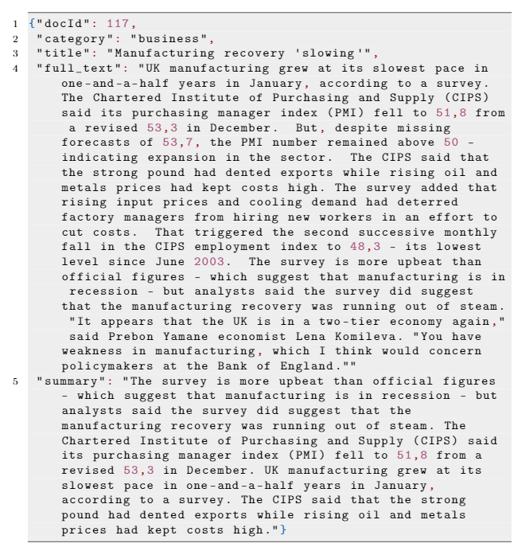
Dataset
BBC News Dataset
2225 documents and their respective summaries (references)
Stories in five topical areas (business, entertainment, politics, sport, tech)
Year: 2004-2005

Slide 7
Implementation Steps
SOLR Configuration
4
TF-IDF
Evaluation
1
Instance Creation
2
Schema Customization
Decision Tree
Evaluation
5
3
Indexing
Feature Extraction
SVM
Evaluation
Naïve Bayes
Evaluation

Slide 8
Architecture
SOLR Server
Client
Indexing
Requests API
Indexed Documents
SOLR Instance
HTTP Request (URL)
Request Wrappers
HTTP Response (JSON)
Instance Creation
SOLR Schema
Python Main
Schema Customization
N.B.: Solr was adopted in its cloud mode, because Streaming expressions are only available in such mode. Streaming expression can extract TF-IDF values from a sub-set of the collection’s documents, or they can run an Analyzer on a particular sentence, extracting processed tokens from that sentence.

Slide 9
SOLR Configuration
SOLR Instance Creation
Schema Customization
Indexing

Slide 10
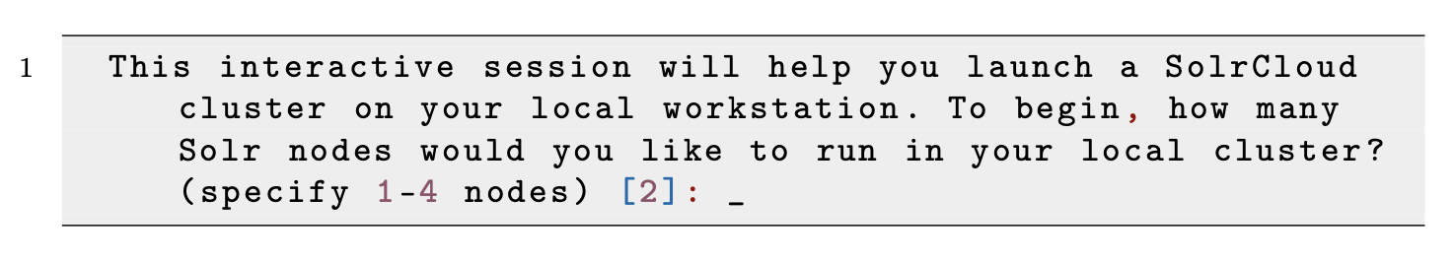
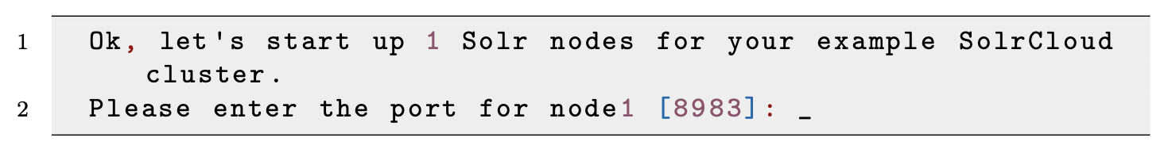
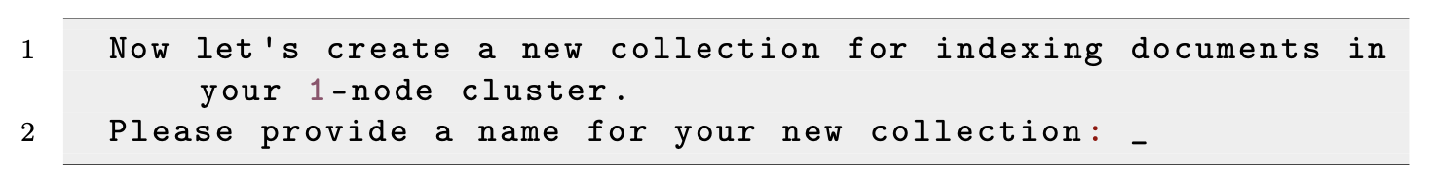
Instance Creation
1. Starting SOLR in cloud mode:
2. Number of nodes:
3. Port number:
4. Collection name:

Slide 11
Schema Customization
Documents are composed of 5 fields :
docId: unique identifier of the document, integer
category: topical area of the article, string
title: title of the article, string
full_text: the article, string
summary: human-generated reference summary, string
Fields belong to one of two fieldTypes :
integer
string
In general, in order to customize SOLR’s schema, we must (1) define custom fieldTypes, if any, and then (2) inject our field names.

Slide 12
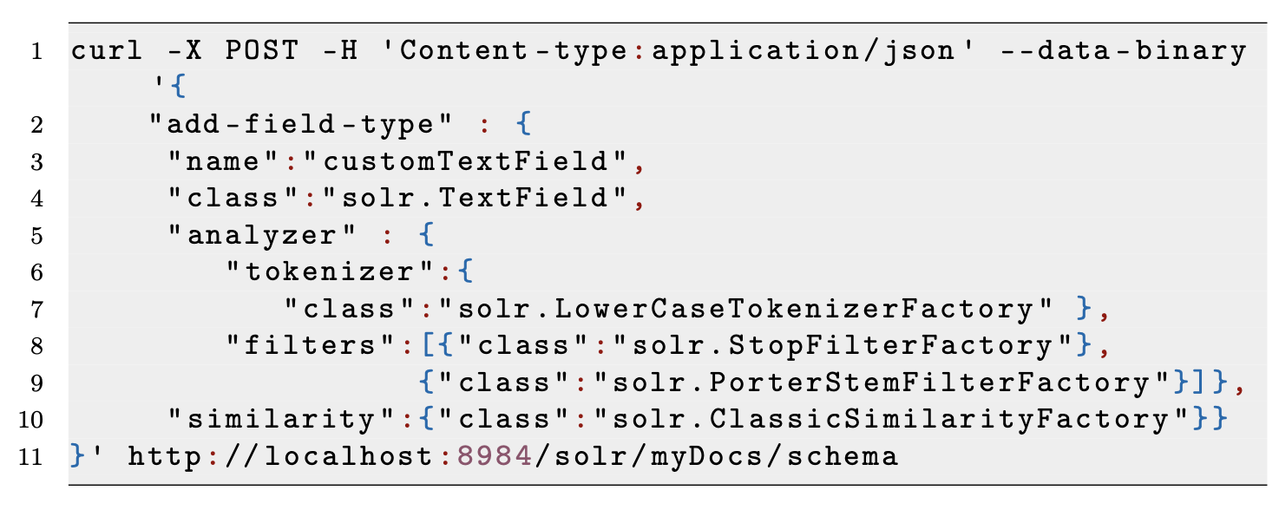
Schema Customization: Custom FieldTypes
Lowercase Tokenizer
Stopwords Filter
Porter Stem Filter
An analyzer examines the text and generates a token stream, which is a set of processed words. The stream is generated according to the specified tokenizers and filters.

Slide 13
Schema Customization: Analyzers
“This is an interesting IRS project example.”
this
is
an
interesting
irs
project
example
interesting
irs
project
example
interest
irs
project
exampl

Slide 14
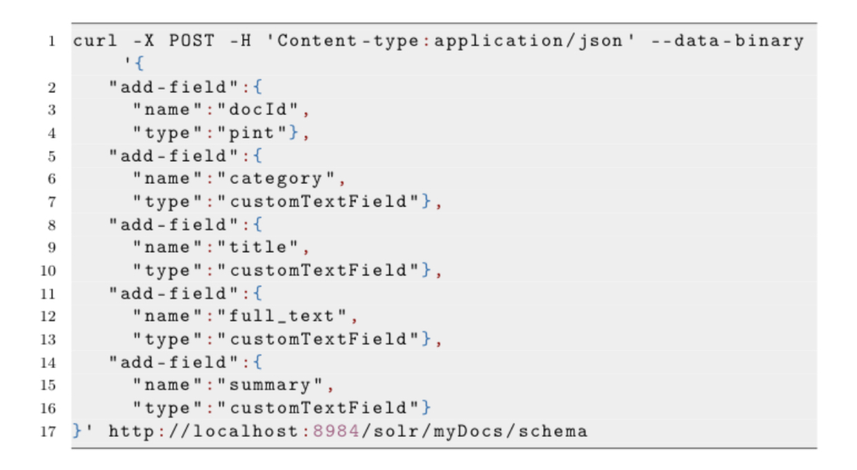
Schema Customization: Field Injection
pint is a standard SOLR fieldType for integers
customTextField is our custom fieldType for strings

Slide 15
Indexing
After the schema operations have been completed, the indexing process is trivial:
Port
Collection
Documents

Slide 16
TF-IDF Summaries
Request Wrappers
Python Processing

Slide 17
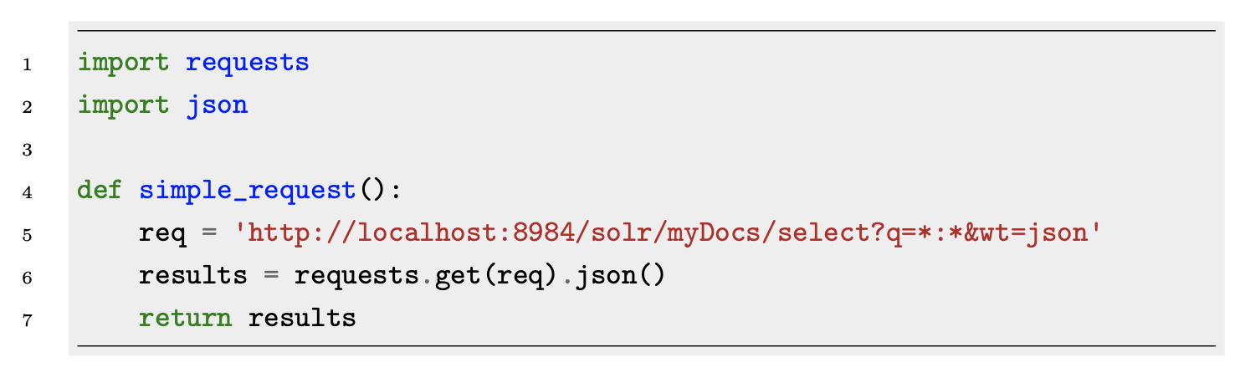
A Simple Request
Query
Alternatively, in 1 line of code:
return requests.get(‘http://localhost:8984/solr/myDocs/select?q=*:*&wt=json’).json()

Slide 18
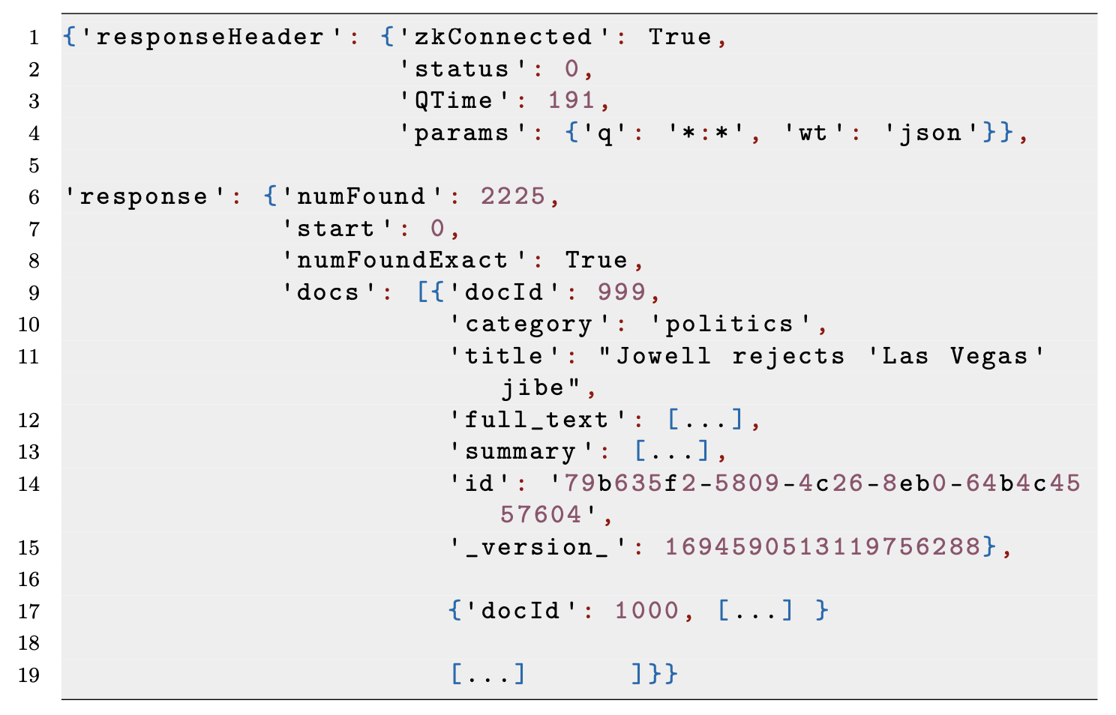
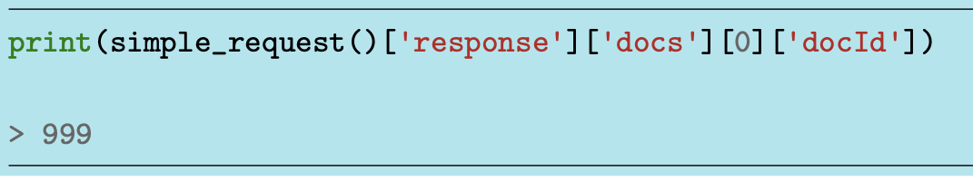
Anatomy of a Response
responseHeader contains connection info
response contains the documents that match the query
We can use dictionary-like notation (json) to access the fields of the response:

Slide 19
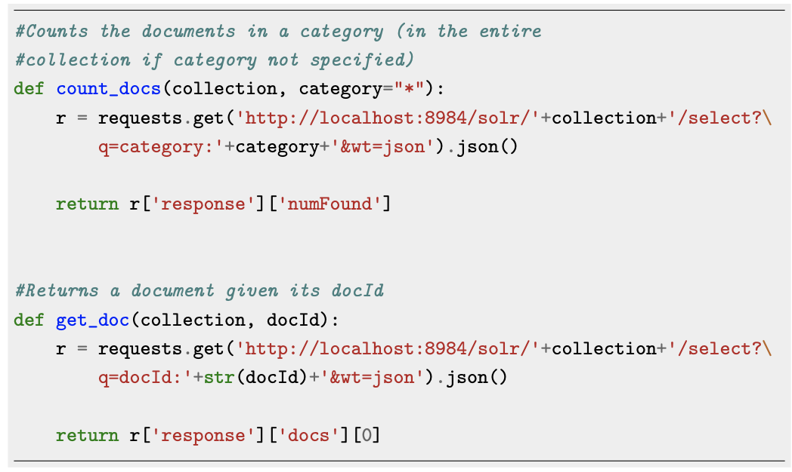
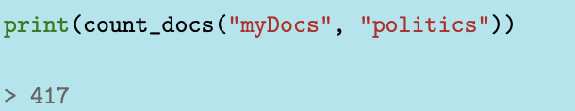
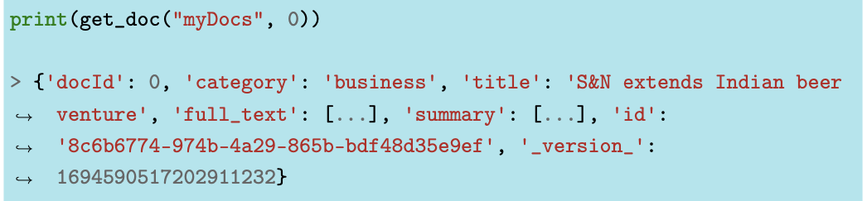
More Sophisticated Requests

Slide 20
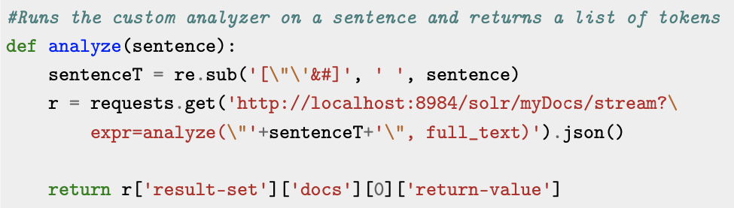
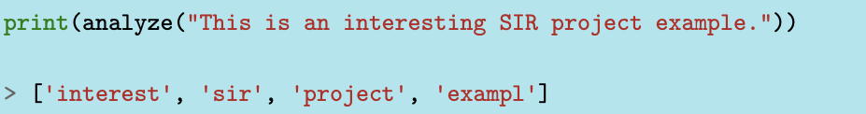
Stream Query
Remember: Stream queries are only available in SOLR Cloud mode

Slide 21
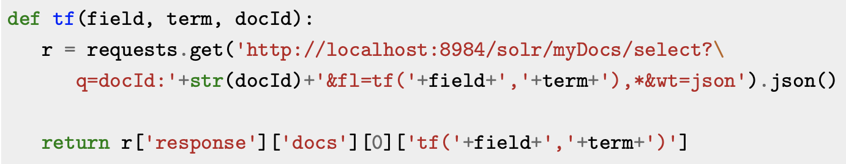
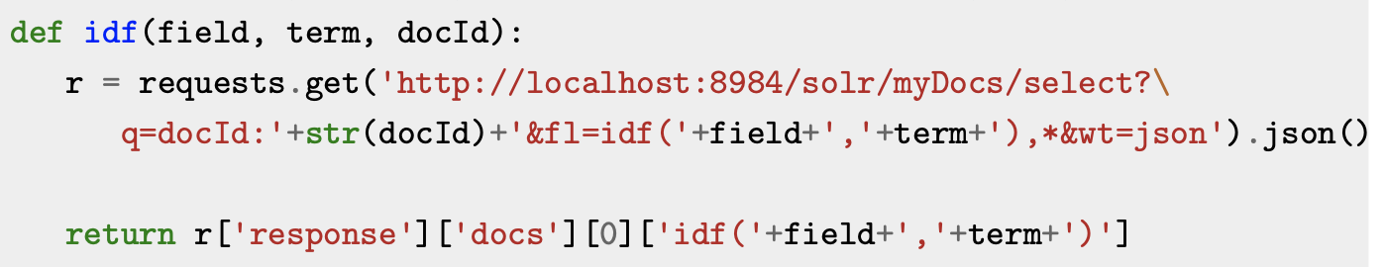
TF-IDF Scores
Returns the TF score of term in document with ID docId.
field specifies that we are working on the full_text field (the article)
Returns the IDF score of term.
N.B.: IDF scores are computed on the entire collection. Here docId was added so that TF and IDF share the same signature.

Slide 22
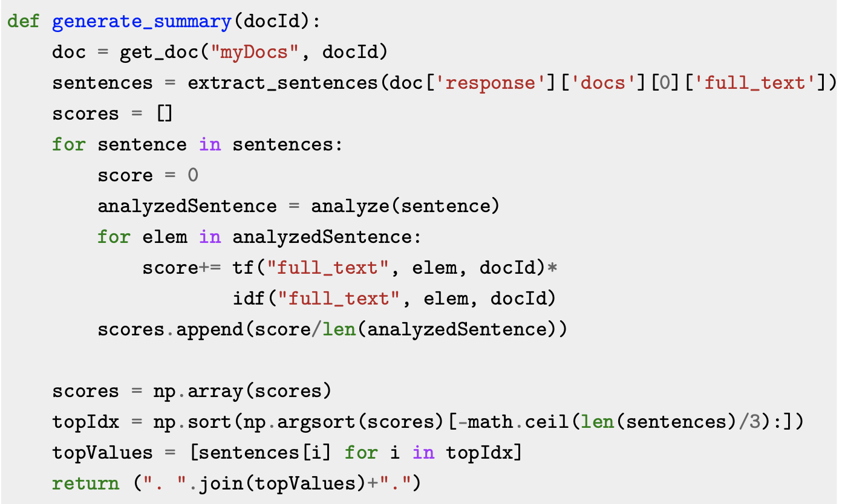
Summary Creation
extract_sentences is a support function that transforms a text into an array of sentences, according to syntax rules.
The number of top sentences to extract is a hyperparameter that depends on the document’s length.
Here is set to a fraction (1/3) of the document’s total number of sentences.

Slide 23
Machine Learning Summaries
Feature Extraction
Model Training

Slide 24
Feature Extraction
Goal: transform sentences into sets of features that represent them and then use those features to train a classifier.
Since we have reference summaries, we can use them to assign a class to a sentence: summary or not_summary.
What kind of features can we extract? And how?

Slide 25
Feature Extraction: What Kind?
Article-Independent Features | Article-Dependent Features
Sentence length (the number of its terms); Presence of proper nouns (boolean); Ratio of nouns to all words in the sentence; Ratio of verbs to all words in the sentence; Ratio of adjectives to all words in the sentence; Ratio of adverbs to all words in the sentence. | TF-ISF value; Sentence Position; Title Similarity; Sentence-to-Sentence Cohesion; Sentence-to-Centroid Cohesion.

Slide 26
Feature Extraction: How?
Reshape the document collection
Each "document" represents a single sentence instead of the entire article
As a result, the documents have the following new structure:
docId: identifier of the article, integer
category: topical area of the article, string
title: title of the article, string
sentence: a sentence of the article, string
summary: whether or not the sentence is part of the summary, boolean

Slide 27
Feature Extraction: How?
The schema for the new collection must be modified accordingly, but the only difference from the earlier schema is in the summary field, which is now a boolean value.
A conceptual difference is instead the docId field: whereas before it represented a unique identifier for each document, now it represents the identifier of the article the sentence belongs to. Different sentences can therefore have the same docId, meaning that they belong to the same news article.
The collection thus created is composed of documents (sentences) which already hold the class value needed for the training of the classifiers. Furthermore, we can easily query single sentences for feature extraction.

Slide 28
Feature Extraction: Article-Dependent
TF-ISF: (Term Frequency – Inverse Sentence Frequency) basically TF-IDF weights but computed on a sentence/article level, rather than on a document/collection level.
Title Similarity: number of term co-occurrences between the sentence and the article title, normalized by the number of total words in the sentence.
Sentence-to-Sentence Cohesion: for each sentence s we first compute the similarity between s and each other sentence s′ of the article; then we add up those similarity values, obtaining the raw value of this feature for s.
Sentence-to-Centroid Cohesion: we compute the vector representing the centroid of the document, which is the arithmetic average over the corresponding weighted vectors of all the sentences of the document; then we compute the similarity between the centroid and each sentence, obtaining the raw value of this feature for each sentence.

Slide 29
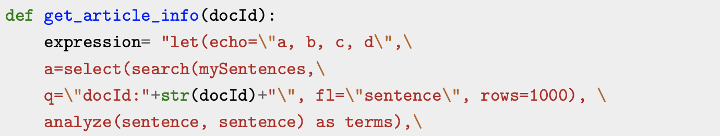
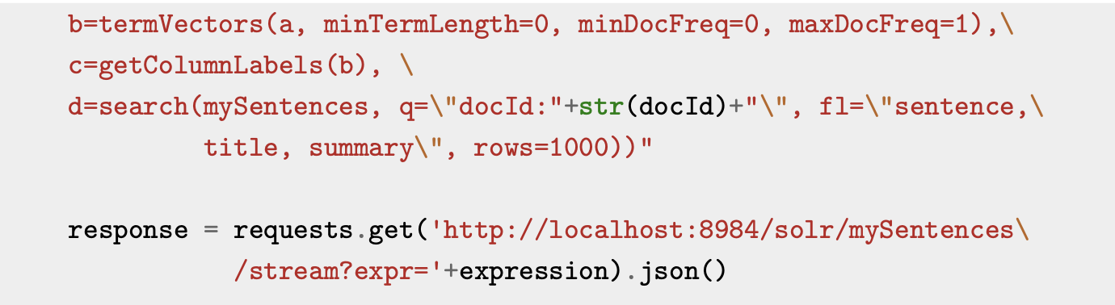
Feature Extraction: Support Function
TF-ISF: (Term Frequency – Inverse Sentence Frequency) basically TF-IDF weights but computed on a sentence/article level, rather than on a document/collection level.

Slide 30
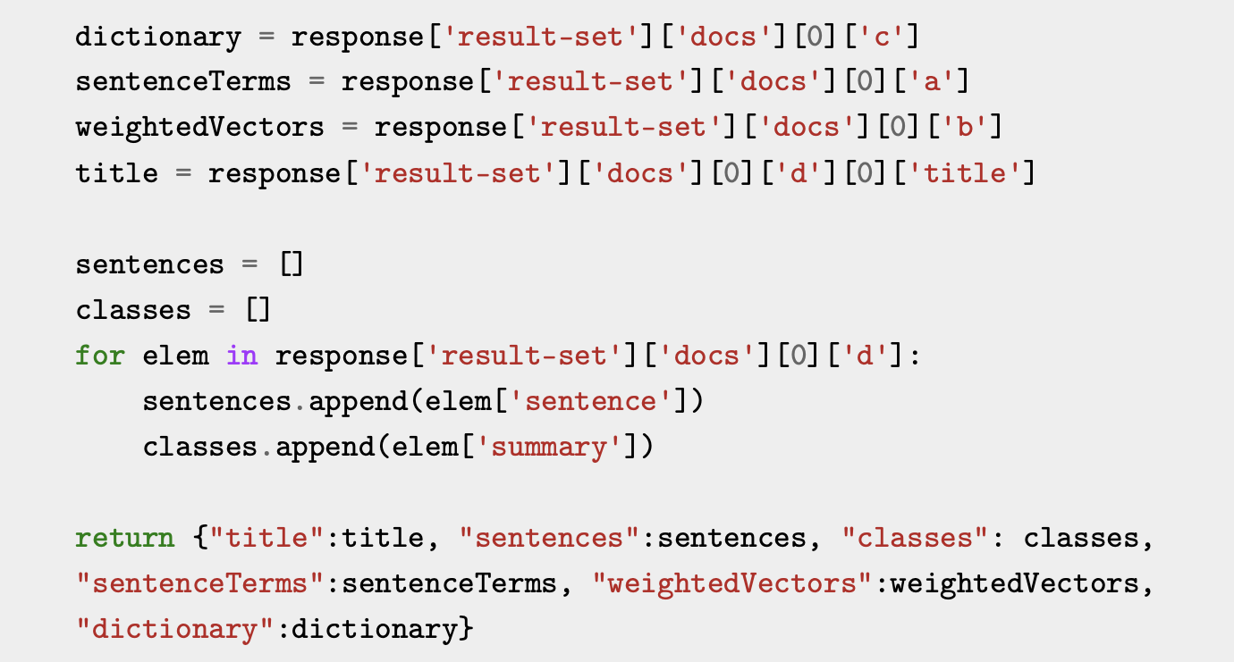
Feature Extraction: Support Function

Slide 31
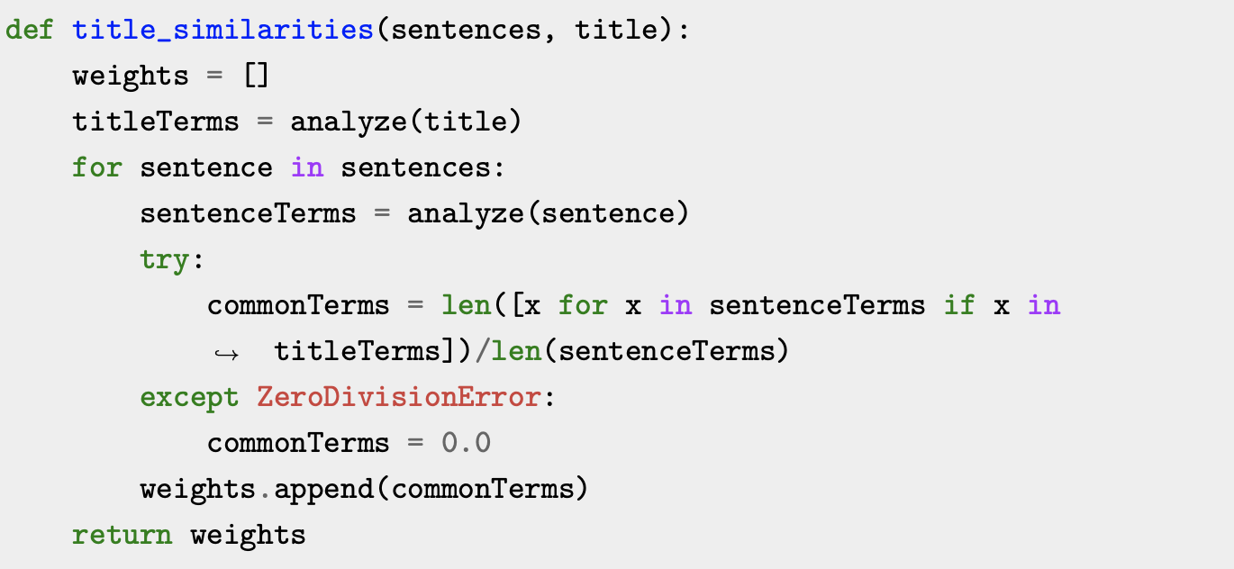
Feature Extraction: Title Similarity
Title Similarity: number of term co-occurrences between the sentence and the article title, normalized by the number of total words in the sentence.

Slide 32
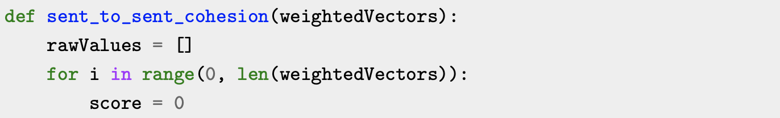
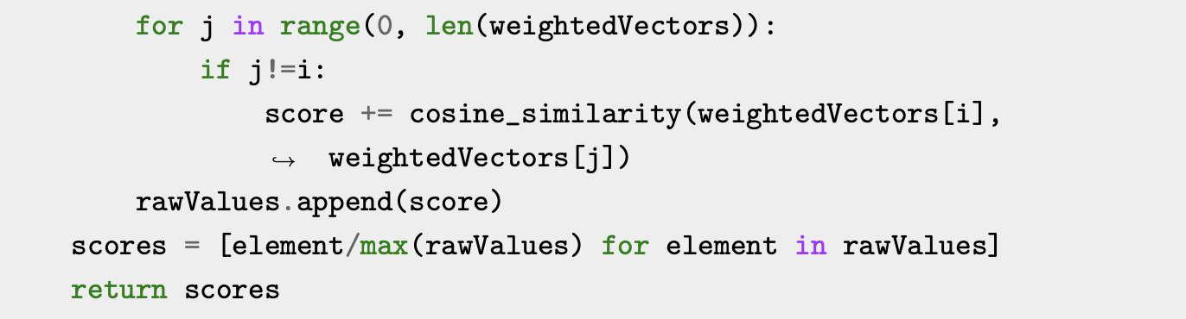
Feature Extraction: Sentence to Sentence Cohesion
Sentence-to-Sentence Cohesion: for each sentence s we first compute the similarity between s and each other sentence s′ of the article; then we add up those similarity values, obtaining the raw value of this feature for s.

Slide 33
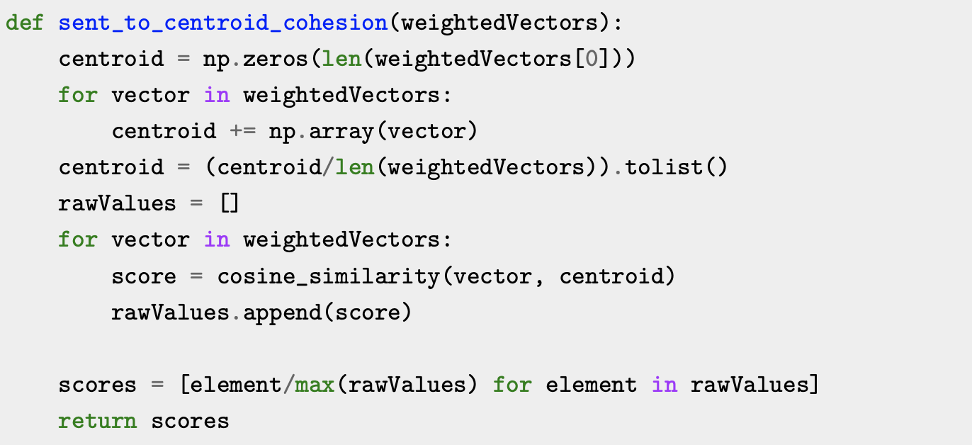
Feature Extraction: Sentence to Centroid Cohesion
Sentence-to-Centroid Cohesion: we compute the vector representing the centroid of the document, which is the arithmetic average over the corresponding weighted vectors of all the sentences of the document; then we compute the similarity between the centroid and each sentence, obtaining the raw value of this feature for each sentence.

Slide 34
Feature Extraction: Article-Independent
Article-Independent features are basically Part-of-Speech (POS) tagging features.
Python’s nltk library provides all the necessary tools to extract the required information.
Through nltk.pos_tag() we count how many nouns/verbs/adjectives/adverbs are in a sentence.
Dividing each number by the number of total words in a sentence we get normalized scores (our features).

Slide 35
Feature Matrix
Sentence | Sentence Length | PN | NR | VR | AdjR | AdvR | TF-ISF | Sentence Position | Title Similarity | STSC | STCC | Class
"You have weakness in manufacturing, which I think would concern policymakers at the Bank of England ." | 12 | 1 | 7/12 | 4/12 | 0/12 | 1/12 | 0.524 | 9/9 | 0.341 | 0.433 | 0.126 | 0
UK manufacturing grew at its slowest pace in one and a half years in January, according to a survey. | 11 | 1 | 8/11 | 1/11 | 1/11 | 1/11 | 0.716 | 1/9 | 0.532 | 0.401 | 0.336 | 1

Slide 36
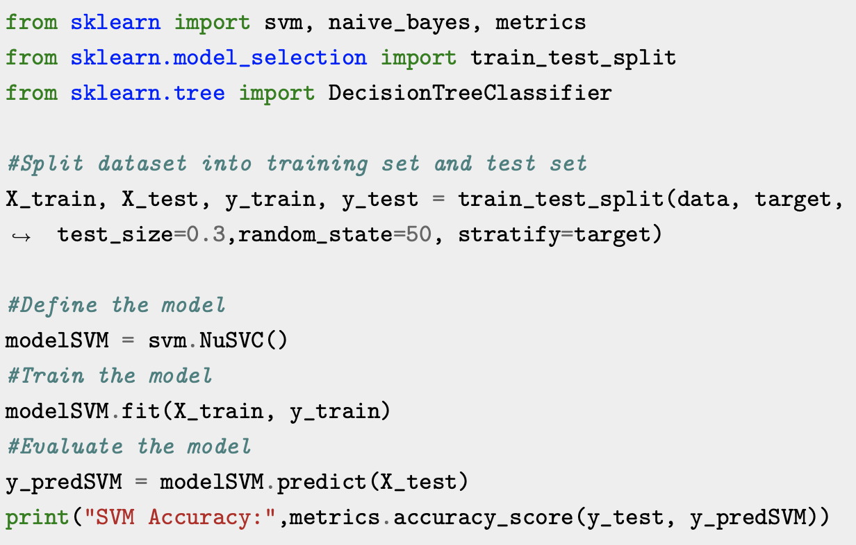
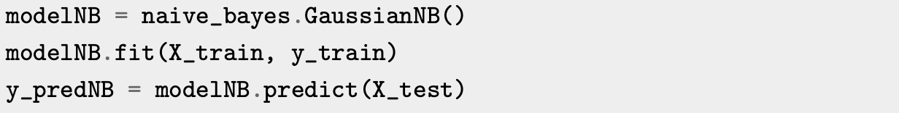
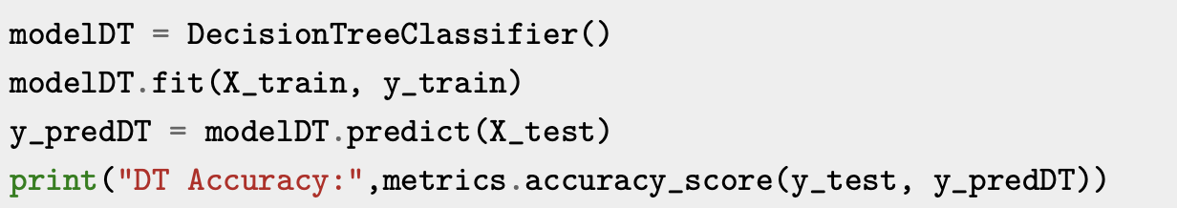
Model Training
SVM
Naïve Bayes
Decision Tree

Slide 37
Evaluation
Classic Metrics
ROUGE

Slide 38
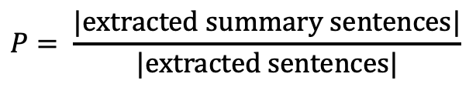
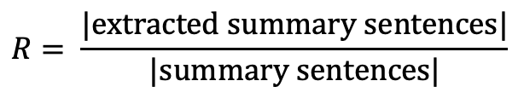
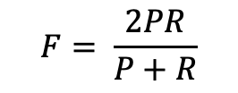
Classic IR Evaluation Metrics
Precision, Recall, F-Measure
$$R= \frac{|\text{extracted} \text{summary} \text{sentences}|}{|\text{summary} \text{sentences}|}$$
Extracted Summary Sentences
Candidate Summary
Reference Summary
$$P= \frac{|\text{extracted} \text{summary} \text{sentences}|}{|\text{extracted} \text{sentences}|}$$
$$F= \frac{2PR}{P+R}$$

Slide 39
ROUGE Scores
Recall-Oriented Understudy for Gisting Evaluation
Determines the quality of a summary by comparing common N-grams among candidate and reference summary
N-gram: contiguous sequence of N words
6 possible scores:
Recall oriented ROUGE-N
Precision oriented ROUGE-N
F-Measure ROUGE-N
Recall oriented ROUGE-L
Precision oriented ROUGE-L
F-Measure ROUGE-L

Slide 40
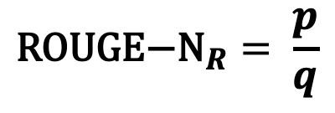
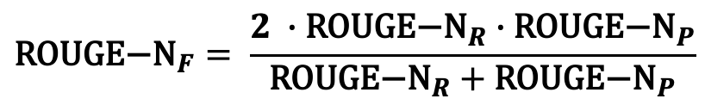
ROUGE-N
N.B.: N is a hyperparameter!
p: number of common N-grams between candidate and reference summary
q: number of N-grams extracted from the reference summary only
$${\text{ROUGE}\text{−}\text{N}}_{R}= \frac{p}{q}$$
${\text{ROUGE}\text{−}\text{N}}_{P}$ q is the number of N-grams extracted from the candidate summary
$${\text{ROUGE}\text{−}\text{N}}_{F}= \frac{2 ∙{\text{ROUGE}\text{−}\text{N}}_{R}∙{\text{ROUGE}\text{−}\text{N}}_{P}}{{\text{ROUGE}\text{−}\text{N}}_{R}+{\text{ROUGE}\text{−}\text{N}}_{P}}$$

Slide 41
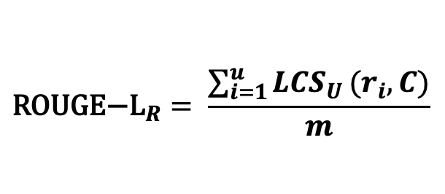
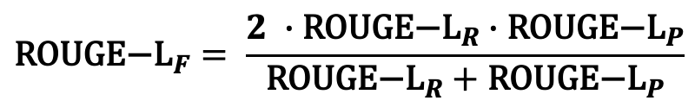
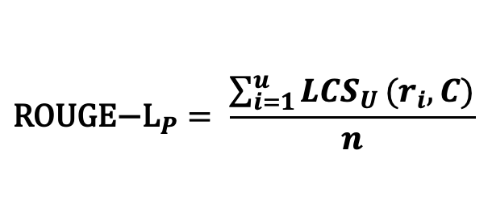
ROUGE-L
u: number of sentences in reference summary
m: number of words in reference summary
LCS_{U}: Union Longest Common Subsequence between reference sentence r_{i} and candidate summary C
$${\text{ROUGE}\text{−}\text{L}}_{R}= \frac{\sum_{i=1}^{u}{{LCS}_{U}}(r_{i}, C)}{m}$$
$${\text{ROUGE}\text{−}\text{L}}_{P}= \frac{\sum_{i=1}^{u}{{LCS}_{U}}(r_{i}, C)}{n}$$
$${\text{ROUGE}\text{−}\text{L}}_{F}= \frac{2 ∙{\text{ROUGE}\text{−}\text{L}}_{R}∙{\text{ROUGE}\text{−}\text{L}}_{P}}{{\text{ROUGE}\text{−}\text{L}}_{R}+{\text{ROUGE}\text{−}\text{L}}_{P}}$$
n: number of words in candidate summary

Slide 42
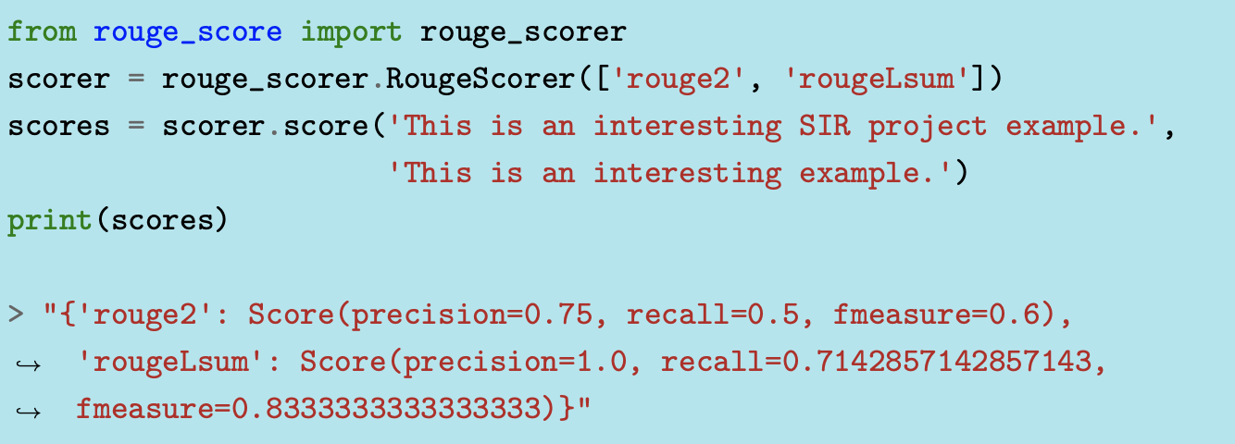
ROUGE in Python
Reference
Candidate

Slide 43
Comparing the Algorithms
We will test the algorithms on the first 100 articles (docId 0-99).
For the TF-IDF version we simply iterate the algorithm on the target articles.
For the Machine Learning algorithms we use the target articles as the test set, and the remaining articles as the training set.

Slide 44
Example
MG Rover’s proposed tie-up with China’s top carmaker has been delayed due to concerns by Chinese regulators, according to the Financial Times. The paper said Chinese officials had been irritated by Rover’s disclosure of its talks with Shanghai Automotive Industry Corp in October. The proposed deal was seen as crucial to safeguarding the future of Rover’s Longbridge plant in the West Midlands. However, there are growing fears that the deal could result in job losses. The Observer reported on Sunday that nearly half the workforce at Longbridge could be under threat if the deal goes ahead. Shanghai Automotive’s proposed £1bn investment in Rover is awaiting approval by its owner, the Shanghai city government and by the National Development and Reform Commission, which oversees foreign investment by Chinese firms. According to the FT, the regulator has been annoyed by Rover’s decision to talk publicly about the deal and the intense speculation which has ensued about what it will mean for Rover’s future. As a result, hopes that approval of the deal may be fast-tracked have disappeared, the paper said. There has been continued speculation about the viability of Rover’s Longbridge plant because of falling sales and unfashionable models. According to the Observer, 3,000 jobs - out of a total workforce of 6,500 - could be lost if the deal goes ahead. The paper said that Chinese officials believe cutbacks will be required to keep the MG Rover’s costs in line with revenues. It also said that the production of new models through the joint venture would take at least eighteen months. Neither Rover nor Shanghai Automotive commented on the reports.

Slide 45
Example
TF-IDF | The paper said Chinese officials had been irritated by Rover’s disclosure of its talks with Shanghai Automotive Industry Corp in October. The proposed deal was seen as crucial to safeguarding the future of Rovers Longbridge plant in the West Midlands. The Observer reported on Sunday that nearly half the workforce at Longbridge could be under threat if the deal goes ahead. There has been continued speculation about the viability of Rovers Longbridge plant because of falling sales and unfashionable models. Neither Rover nor Shanghai Automotive commented on the reports.
SVM | The paper said Chinese officials had been irritated by Rover’s disclosure of its talks with Shanghai Automotive Industry Corp in October. According to the FT, the regulator has been annoyed by Rover’s decision to talk publicly about the deal and the intense speculation which has ensued about what it will mean for Rover’s future.
NB | MG Rover’s proposed tie-up with China’s top carmaker has been delayed due to concerns by Chinese regulators, according to the Financial Times. The paper said Chinese officials had been irritated by Rover’s disclosure of its talks with Shanghai Automotive Industry Corp in October. The proposed deal was seen as crucial to safeguarding the future of Rover’s Longbridge plant in the West Midlands. Shanghai Automotive’s proposed £1bn investment in Rover is awaiting approval by its owner, the Shanghai city government and by the National Development and Reform Commission, which oversees foreign investment by Chinese firms. According to the FT, the regulator has been annoyed by Rover’s decision to talk publicly about the deal and the intense speculation which has ensued about what it will mean for Rover’s future. There has been continued speculation about the viability of Rover’s Longbridge plant because of falling sales and unfashionable models. The paper said that Chinese officials believe cutbacks will be required to keep the MG Rover’s costs in line with revenues.
DT | MG Rover’s proposed tie-up with China’s top carmaker has been delayed due to concerns by Chinese regulators, according to the Financial Times. The paper said Chinese officials had been irritated by Rover’s disclosure of its talks with Shanghai Automotive Industry Corp in October. The proposed deal was seen as crucial to safeguarding the future of Rover’s Longbridge plant in the West Midlands. The Observer reported on Sunday that nearly half the workforce at Longbridge could be under threat if the deal goes ahead. According to the FT, the regulator has been annoyed by Rover’s decision to talk publicly about the deal and the intense speculation which has ensued about what it will mean for Rover’s future. According to the Observer, 3,000 jobs - out of a total workforce of 6,500 - could be lost if the deal goes ahead.

Slide 46
Comparing the Algorithms
Values of ROUGE-1, ROUGE-2, ROUGE-3, and ROUGE-L were computed for the first 100 automatic generated summaries, both for the TF-IDF algorithm and the Machine Learning algorithms. The values were then averaged over the 100 documents.
 | ROUGE-1 |  |  | ROUGE-2 |  |  | ROUGE-3 |  |  | ROUGE-L
 | P | R | F | P | R | F | P | R | F | P | R | F
TF-IDF | 0.5776 | 0.7614 | 0.6537 | 0.4901 | 0.6470 | 0.5551 | 0.4562 | 0.6036 | 0.5172 | 0.4019 | 0.5301 | 0.4549
SVM | 0.0507 | 0.2552 | 0.0821 | 0.0481 | 0.2519 | 0.0784 | 0.0463 | 0.2508 | 0.0759 | 0.0477 | 0.2476 | 0.0778
NB | 0.8695 | 0.7152 | 0.7669 | 0.8158 | 0.6684 | 0.7178 | 0.7859 | 0.6432 | 0.6908 | 0.5597 | 0.4658 | 0.4963
DT | 0.7155 | 0.6944 | 0.6831 | 0.6259 | 0.6071 | 0.5965 | 0.5937 | 0.5766 | 0.5658 | 0.4690 | 0.4632 | 0.4501

Slide 47
References
Allahyari, Mehdi, et al. Text summarization techniques: a brief survey.
Abhijit, Roy. Understanding Automatic Text Summarization-1: Extractive Methods.
Chin-Yew Lin. ROUGE: A Package for Automatic Evaluation of Summaries.
Joel Larocca, et al. Automatic Text Summarization using a Machine Learning Approach.
Alexander Dlikman, Mark Last. Using Machine Learning Methods and Linguistic Features in Single-Document Extractive Summarization.
Apache Solr Reference Guide: https://solr.apache.org/guide/8_8/index.html

Slide 48
Thanks!
Aldo Altobelli
al.altobelli@studenti.unina.it

